Slide 1

Marathwada Mitra Mandal's
COLLEGE OF ENGINEERING, Karve Nagar, Pune - 52
An Autonomous Institute Affiliated to SPPU
Website: www.mmcoe.edu.in email id: mmcoe@mmcoe.edu.in
Department of Information Technology
Project Based Learning - Review 2 (AY 2025-26)
“SwachhaMitra- Report
Trash, Earn Rewards”
Presented By: SI160 – Rushikesh.D.Gadekar
SI146 – Sharvari.S.Aralkar
SI134 – Nikita.N.Kumbhar
SI164 – Aditya.B.Patil
Name of Guide:
Mrs.P.S.Joshi
29.10.25
Date:

Slide 2
CEP Project Title
Title 1
Context of the project :- Urban areas are facing persistent waste management challenges due to unreported and unattended garbage piles. These uncollected wastes not only degrade the city’s aesthetic appeal but also create serious public health hazards, including the spread of diseases through pests and contamination of soil and water. Existing reporting systems are often slow, inconvenient, or poorly integrated with municipal response teams, leading to significant delays in action. Area/Community of focus:The project focuses on urban and semi-urban areas affected by poor waste collection. It aims to help municipal bodies and local communities maintain cleanliness in public and residential zones through citizen participation and digital reporting.

Slide 3
Proposed Solution
Description:SwachhaRakshak is a web application that uses GPS tracking and AI automation to improve urban waste management. Citizens can report garbage by uploading images with location details, while AI helps classify waste and assist municipal teams in prioritizing cleanup. The system ensures quick response, transparency, and citizen participation.
Technology/Tools/Approach used:
Frontend: HTML,CSS, JS
Backend: NODE JS
Database: Firebase
APIs: Google Maps API (for GPS tracking)
AI Automation: Image-based waste detection and report prioritization
Approach: Real-time updates with secure, cloud-based architecture

Slide 4
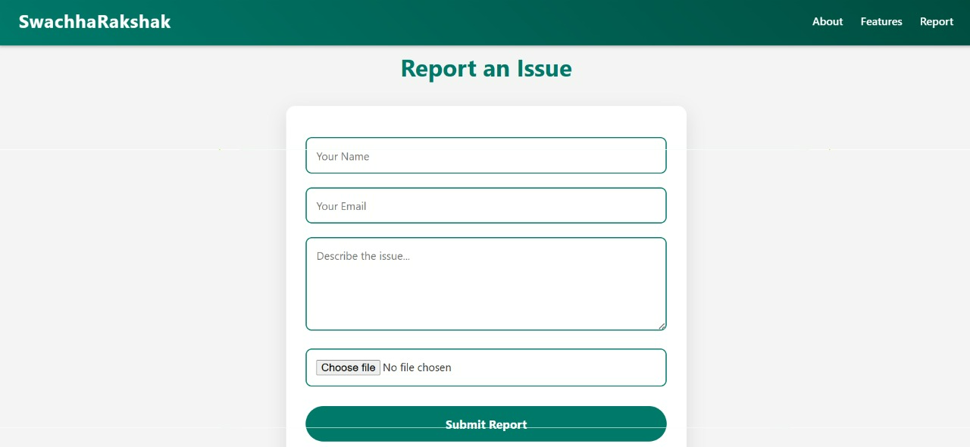
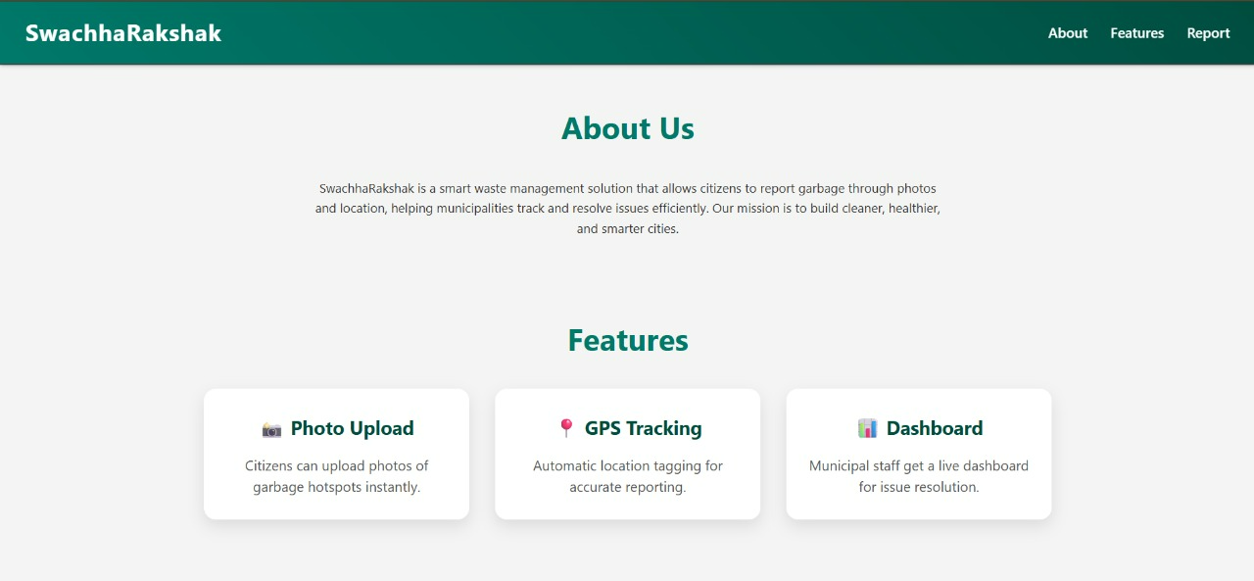
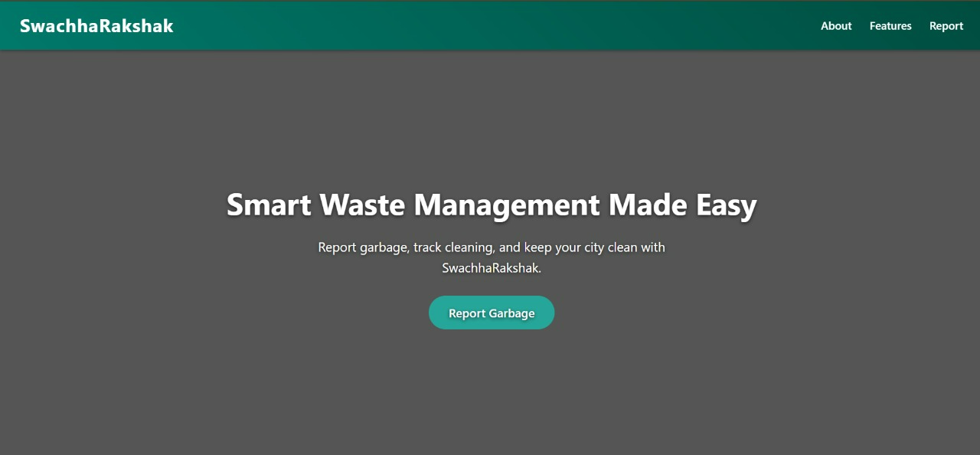
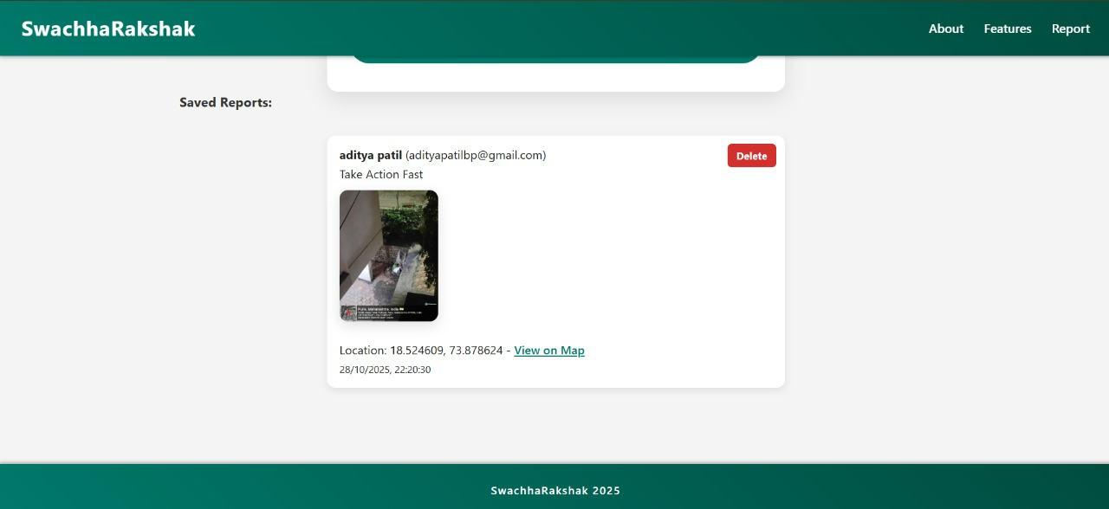
Prototype or Model
Photos/screenshots

Slide 5
Testing and Feedback
Testing & Feedback
Demo with community members:
The system was tested with a small group of community members. Users successfully reported garbage using GPS and image uploads. Feedback highlighted the app’s ease of use and quick response time. Minor suggestions included adding a mobile version and more reward options.
Observations:
Reports were accurately logged with correct location data.
Real-time updates improved user confidence.
AI detection worked well for basic waste categories.
Overall response from users and municipal staff was positive.

Slide 6
Feasibility and Sustainability
Can it be scaled or maintained?
Yes, the project can be easily scaled by integrating more advanced features, improving automation, and expanding to larger datasets or multiple locations. Regular updates and modular design make maintenance manageable.
Cost and complexity:
The cost is moderate, mainly for hardware setup and AI integration. Complexity depends on the automation level — higher AI accuracy and GPS precision increase both cost and system complexity.

Slide 7
Final Outcome
Before vs. After Comparison:
Earlier, waste reporting was a manual and time-consuming process, often leading to delays and incomplete information. With SwachhaRakshak, reporting became quick and efficient through GPS tracking and image uploads. Response time, which was previously delayed, improved with real-time alerts. Transparency also increased — users can now track the status of their reports. Moreover, citizen participation grew significantly, as the system made it easier and more rewarding for people to get involved.
Impact estimate
Response time reduced .
Higher citizen participation and faster issue resolution.
Improved cleanliness and municipal efficiency.

Slide 8
Team Contributions and Learning
Role of Each Member.
Frontend Developer/Backend Developer: Aditya Patil
AI/Automation Developer: Rushikesh Gadekar
UI/UX Designer:Sharvari Aralkar
Documentation Lead: Nikita Kumbhar
What Was Learned Through the Project
Practical application of web development frameworks.
Integration of AI and GPS technologies in real-time systems.
Team coordination and project management.
Skills Gained
Web development
AI and automation basics
Real-time data handling
Problem-solving and teamwork

Slide 9
Future Scope
Future Scope
The project can be expanded with advanced AI models for better waste type detection and predictive analysis of garbage hotspots. Integration with IoT-based smart bins and mobile app support can further improve efficiency. The system can also include multilingual support and city-wide analytics dashboards for municipal planning.
Suggestions for Next Steps or Future Work
Develop a dedicated mobile app version for broader accessibility.
Integrate IoT sensors for automatic garbage level monitoring.
Implement AI-based route optimization for garbage collection vehicles.
Add community leaderboards and reward partnerships for greater user engagement.
Collaborate with municipal authorities for real-time operational deployment.

Slide 10
Thank You

